Slide 1
Bots Are The Future
so are you.

Slide 2
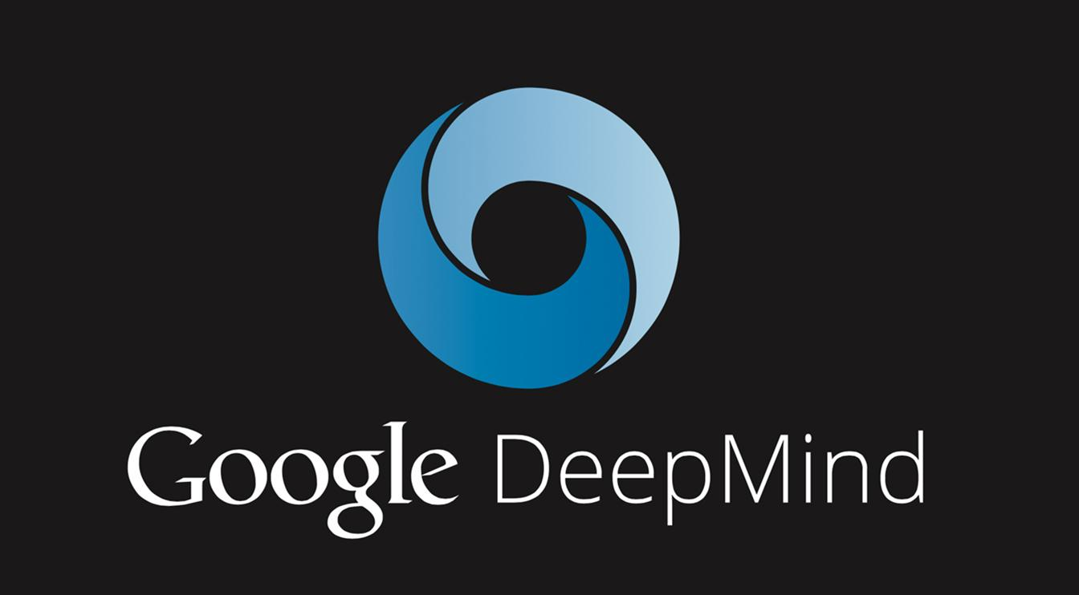
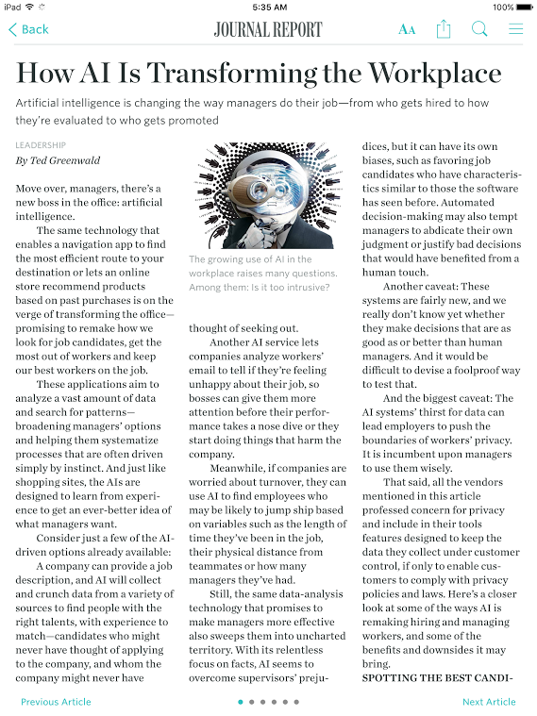
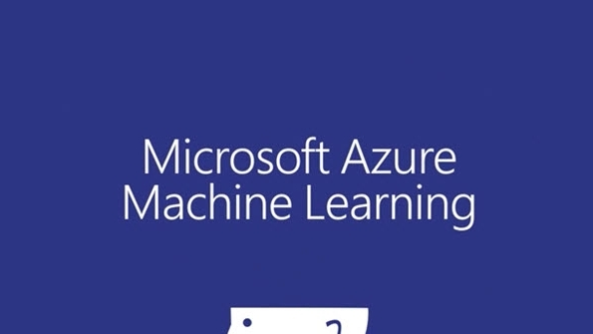
Hey, I’m Tali
Artificial intelligence
> .5 Billion Dollar Industry
= 💰💰💰💰💰💰💰 + jobs

Slide 3
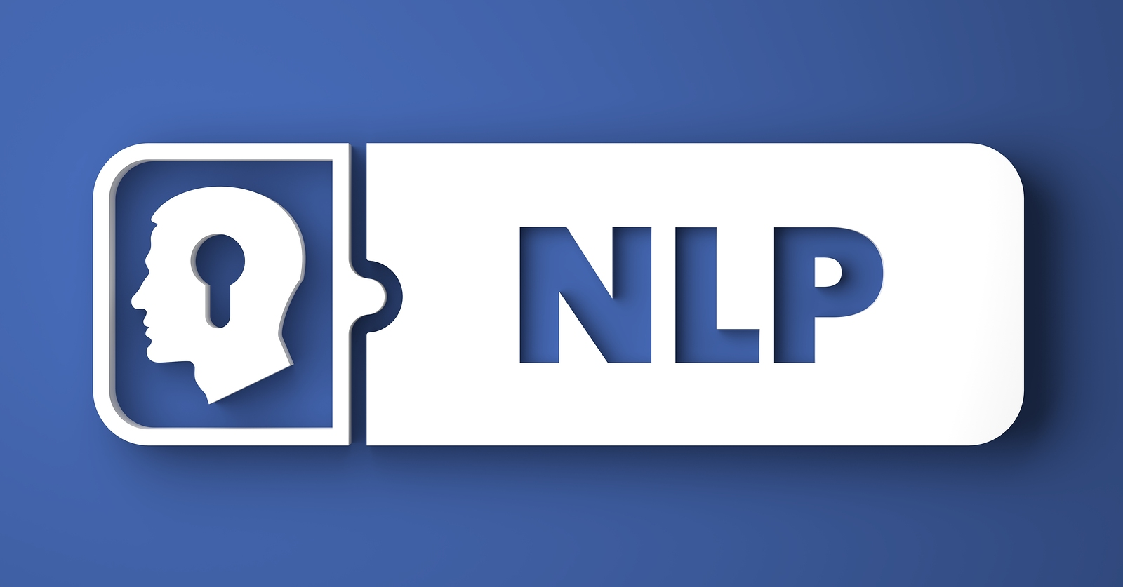
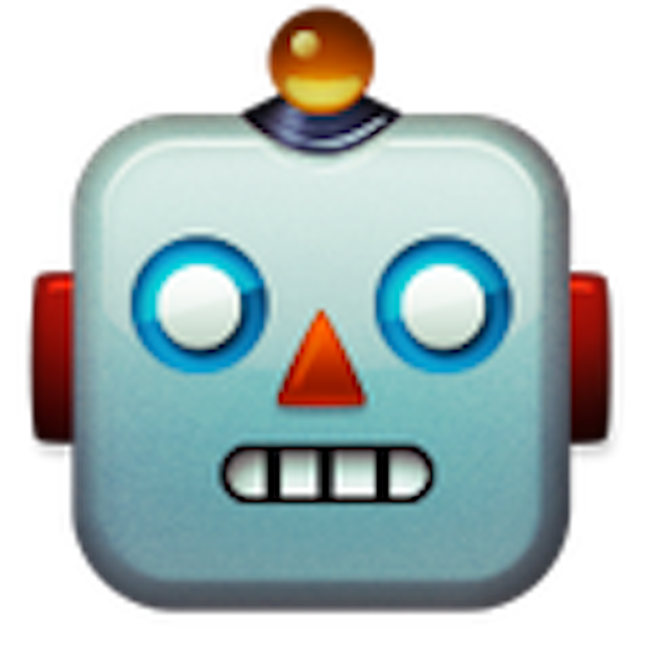
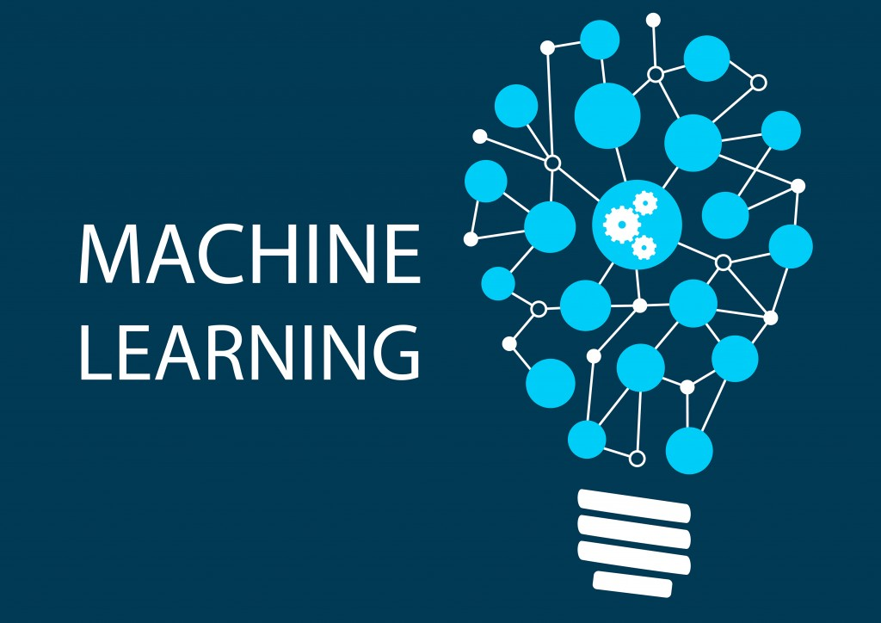

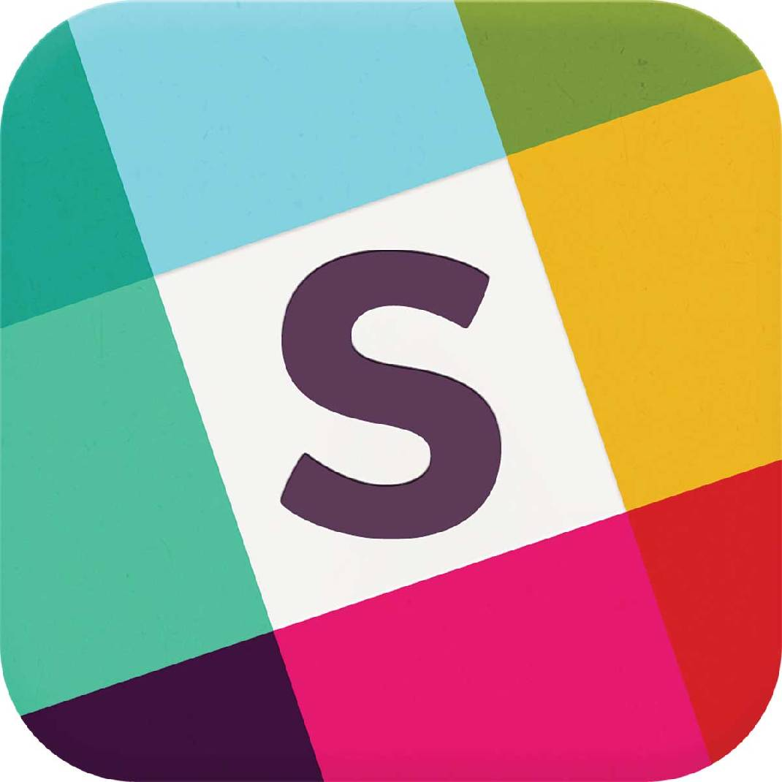

What’s a Bot?

Slide 4
Bots in action
Stern Dorm Bot
ForbesBot
ShaBot
Wade and Wendy!

Slide 5
Slang
(engineering-----------) NLP / NLG (-------------linguistics)
Wit.ai + Luis.ai
This Stanford Youtube series and this NLP toolkit for Python devs
Machine Learning
Enroll in this free Coursera Course from Stanford
Artificial Intelligence / Chatbots

Slide 6
Build Your Own!
WeatherBot For Ruby Developers
Any Bot For Anybody!

